Slide 1
Secondary Electron Detector
Ana Zehtabi Oskuie

Slide 2
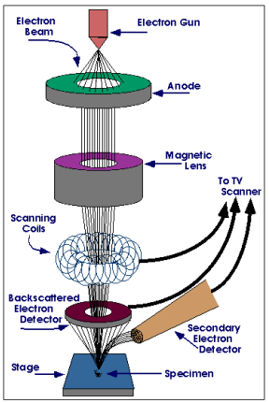
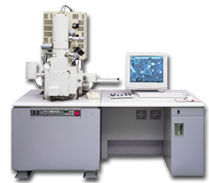
SEM basics:
The electron beam interaction with near surface specimen atoms will make a signal which results in the SEM image.
Introduction Secondary electron secondary electron detector

Slide 3
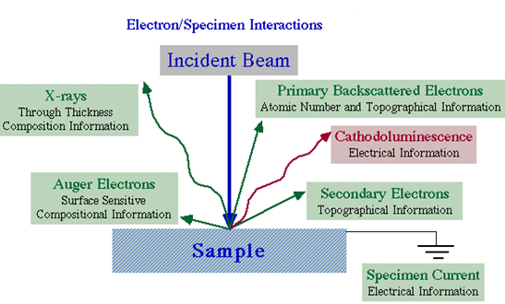
Introduction Secondary electron secondary electron detector

Slide 4
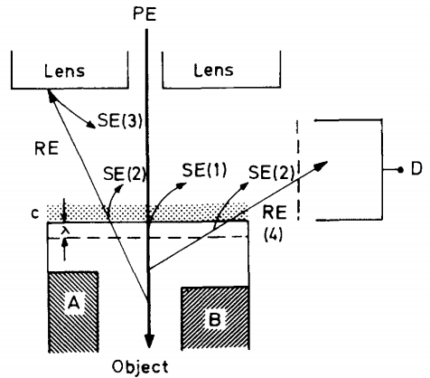
Secondary electrons:
Secondary electrons are generated from the collision between the incoming electrons and the loosely bonded outer electrons
The scattered secondary electrons are categorized into three different types.
Introduction Secondary electron secondary electron detector

Slide 5
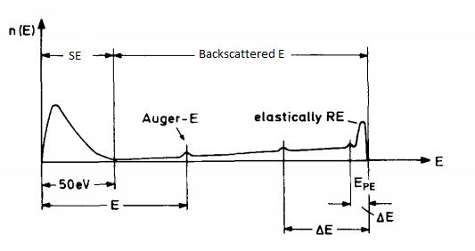
Electrons with energies E <50 e V: Secondary electrons (SE);
(2) Electrons with energies 50 eV < E < E_{PE}: Inelastically backscattered and elastically reflected electrons (RE).
Introduction Secondary electron secondary electron detector

Slide 6
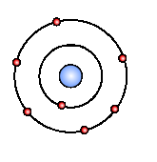
SE1:
First kind of secondary electrons are generated by the incoming electron beam as they enter the surface.
The resulted image has high resolution which is only limited by the electron beam diameter.
As SE1 is generated by near surface atoms so this kind of secondary electron is independent of V .
acc
Introduction Secondary electron secondary electron detector

Slide 7
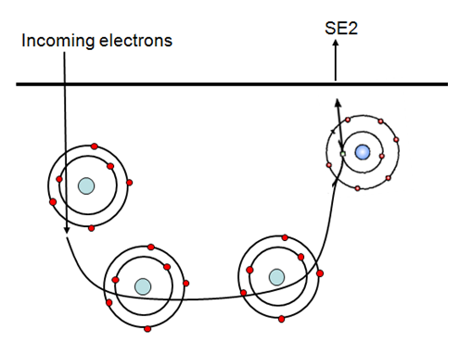
SE2:
The secondary electrons that are generated by the backscattered electrons have returned to the surface after several inelastic scattering events
SE2 come from a surface area which is bigger than the spot of the incoming electrons , also bigger than surface area of SE1. Therefore resolution is less than resolution of SE1 exclusively.
Introduction Secondary electron secondary electron detector

Slide 8
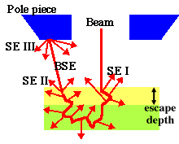
SE3:
The generator of this kind is the SE2 that enters the lens surface and get scattered. Thus, it will result in a decrease of resolution.
Introduction Secondary electron secondary electron detector

Slide 9
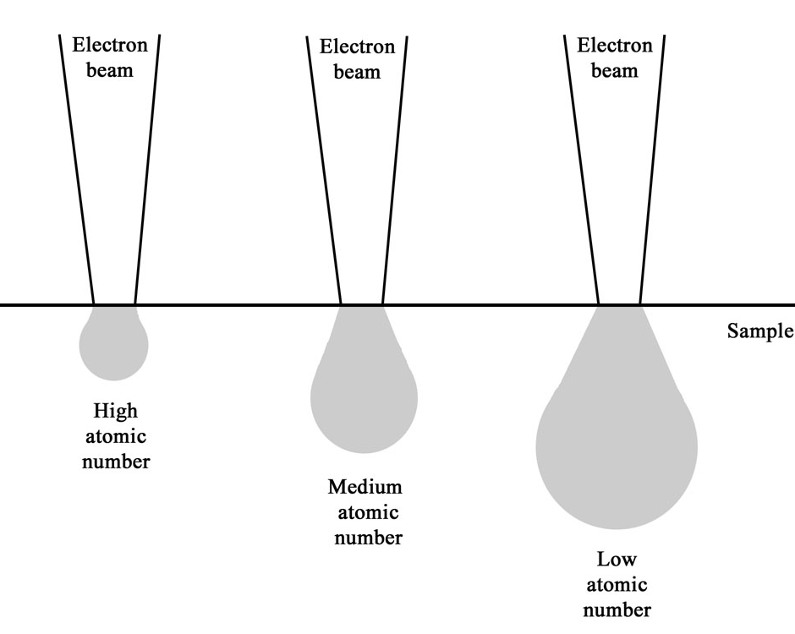
Factors that affect Secondary Electron emission:
1- Atomic number (Z)
More SE2 are created with increasing Z
Introduction Secondary electron secondary electron detector

Slide 10
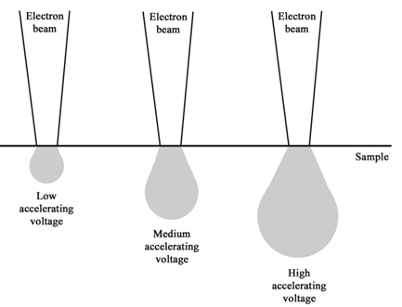
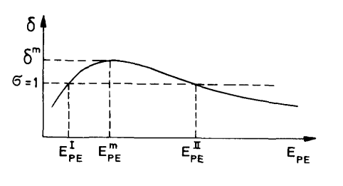
2- Beam energy and beam current
Electron yield goes through a maximum at low acc. voltage, then decreases with increasing acc. voltage
Introduction Secondary electron secondary electron detector

Slide 11
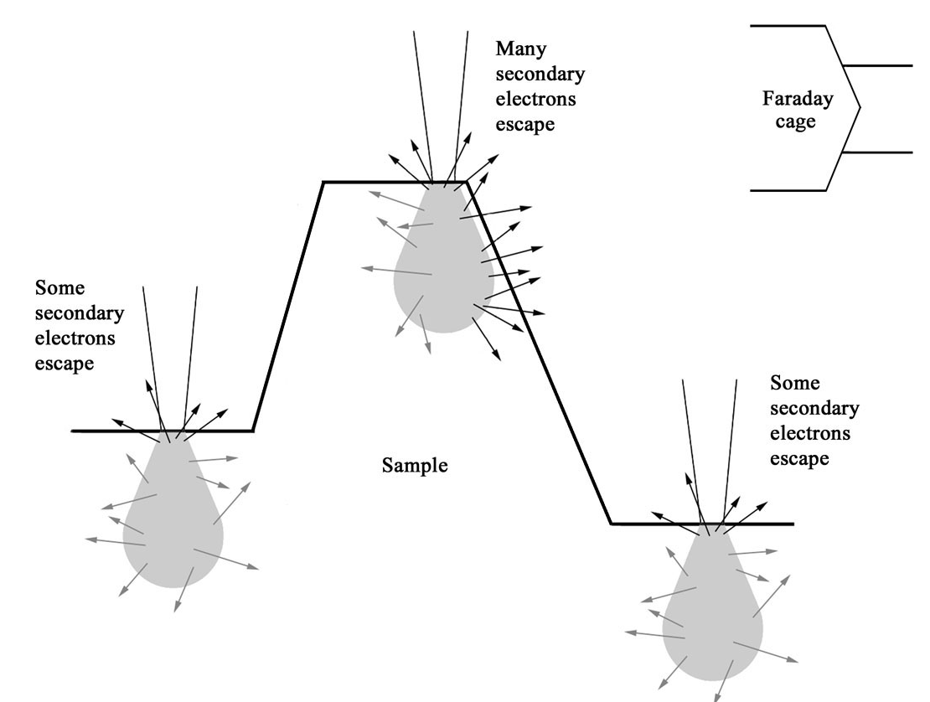
3- The most important factor is the local curvature of the surface.
If we have a edge more secondary electron can be emitted from specific spot.
Introduction Secondary electron secondary electron detector

Slide 12
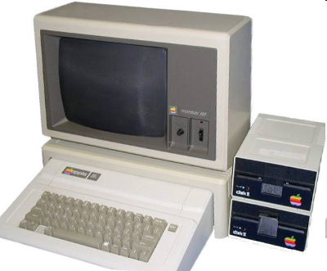
How do we get an image?!
156 electrons!
288 electrons!
Detector
Image
Introduction Secondary electron secondary electron detector

Slide 13
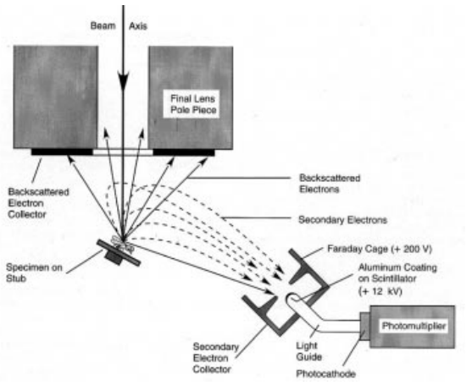
Everhart-Thornley Detector
• Secondary electrons (SE) are attracted to Faraday cage because of its positive charge.
• Detector surface inside faraday cage (+12kV) accelerates electrons.
• Scintillator layer gives off photons when struck by electrons.
• Light travels down the light tube (LG) and hits photocathode and converted back to electrons.
Introduction Secondary electron secondary electron detector

Slide 14
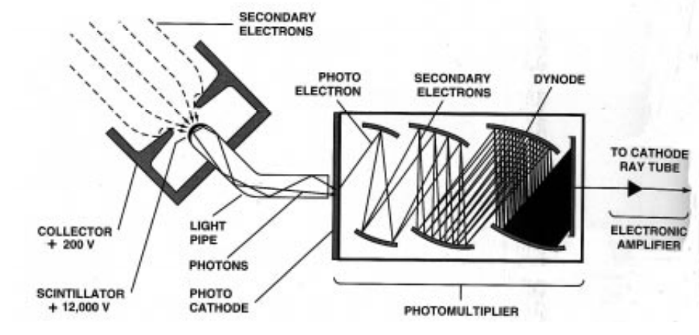
Photomultiplier Tube:
– It’s Entrance is coated with photocathode which has low work function, absorbs photons from
scintillator and emits low-E photoelectrons.
– SE repeatedly accelerated towards N successive dynodes biased at ~+100 V positive
with respect to the last, producing more excess SE. (total increase can be as high as 10⁶).
Introduction Secondary electron secondary electron detector

Slide 15
This amplification or gain, is controlled by the contrast control on the SEM. An increase in contrast is seen as a selective increase in the highlights of the image,
rather then the shadows.
The brightness of the image is controlled by the preamplifier or brightness control. In this case, both highlights and shadow areas of the image are amplified by the same amount.
Introduction Secondary electron secondary electron detector

Slide 16
Signal to noise ratio:
Signal-to-noise ratio is defined as the power ratio between a signal and the background noise:
Therefore, it would be a good way to measure image quality.
Introduction Secondary electron secondary electron detector

Slide 17
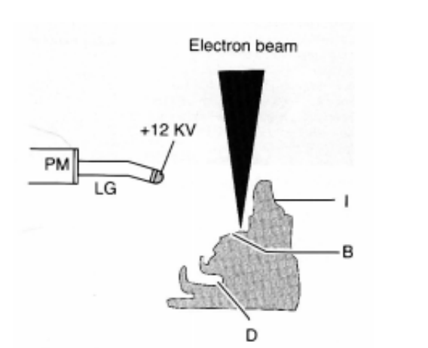
Factors that affect quality of image:
backscattered electrons that have low energy cannot escape Faraday electric field and their absorption will generate a noise signal in our output.
Electrical circuitries such as amplifier that are used in our detector produce noise that affects our output .
In the diagram , as the beam scans from left to right, areas marked (B) will be bright because they are scanned by the beam and in the line of sight of the detector. Areas marked (I) are intermediate in brightness because they are out of the line of sight of the detector.
Introduction Secondary electron secondary electron detector

Slide 18
Regions D will be dark because they are not scanned with the beam at all.
Tilting the specimen will alter the specimen topography relative to the beam and detector and may enhance or reduce image quality.
Introduction Secondary electron secondary electron detector

